Slide 1
Introduction to Differential Equations - Lecture 8
Fei Qi
Email: fei.qi@du.edu
Office Hour: TBA
Website: https://feiqimath.github.io

Slide 2
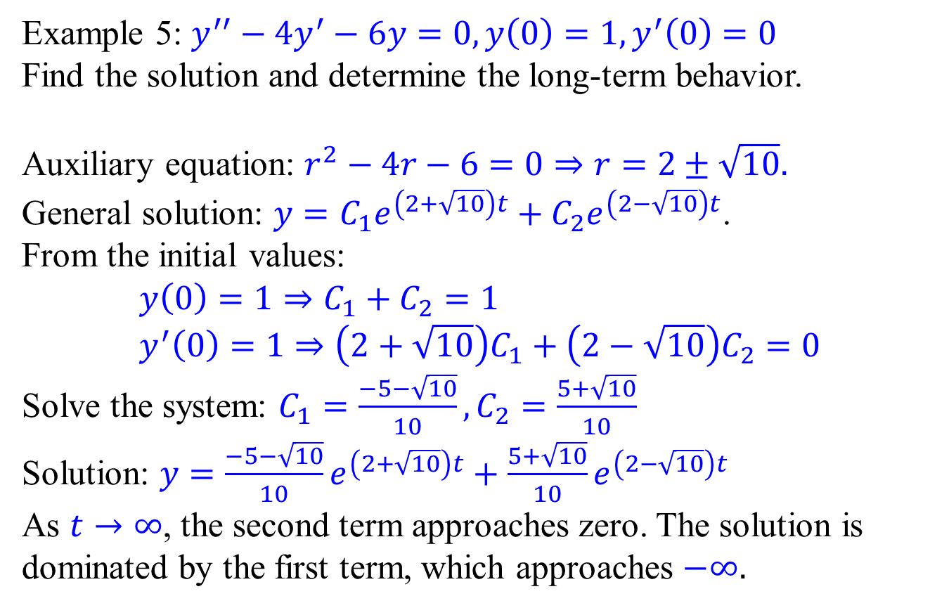
Initial Value Problems & Long-term behaviors
Example 5: $y^{′′}−4y^{′}−6y=0, y\left(0\right)=1,y^{′}\left(0\right)=0$
Find the solution and determine the long-term behavior.
Auxiliary equation: $r^{2}−4r−6=0⇒r=2±\sqrt{10}.$
General solution: $y=C_{1}e^{\left(2+\sqrt{10}\right)t}+C_{2}e^{\left(2−\sqrt{10}\right)t}$.
From the initial values:
$$y\left(0\right)=1⇒C_{1}+C_{2}=1 \\ y^{′}\left(0\right)=1⇒\left(2+\sqrt{10}\right)C_{1}+\left(2−\sqrt{10}\right)C_{2}=0$$
Solve the system: $C_{1}=\frac{−5−\sqrt{10}}{10},C_{2}=\frac{5+\sqrt{10}}{10}$
Solution: $y=\frac{−5−\sqrt{10}}{10}e^{\left(2+\sqrt{10}\right)t}+\frac{5+\sqrt{10}}{10}e^{\left(2−\sqrt{10}\right)t}$
As $t→∞$, the second term approaches zero. The solution is dominated by the first term, which approaches $−∞.$

Slide 3
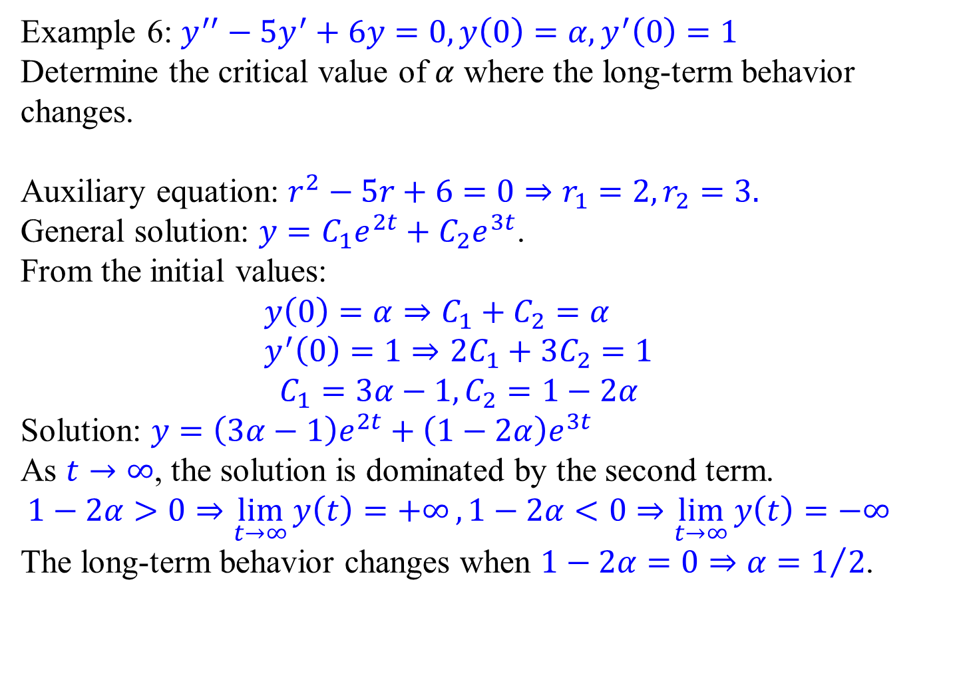
Initial Value Problems & Long-term behaviors
Example 6: $y^{′′}−5y^{′}+6y=0, y\left(0\right)=α,y^{′}\left(0\right)=1$
Determine the critical value of $α$ where the long-term behavior changes.
Auxiliary equation: $r^{2}−5r+6=0⇒r_{1}=2,r_{2}=3.$
General solution: $y=C_{1}e^{2t}+C_{2}e^{3t}$.
From the initial values:
$$y\left(0\right)=α⇒C_{1}+C_{2}=α \\ y^{′}\left(0\right)=1⇒2C_{1}+3C_{2}=1$$
$$C_{1}=3α−1,C_{2}=1−2α$$
Solution: $y=\left(3α−1\right)e^{2t}+\left(1−2α\right)e^{3t}$
As $t→∞$, the solution is dominated by the second term.
$$1−2α>0⇒\lim_{t→∞}{y\left(t\right)=+∞},1−2α<0⇒\lim_{t→∞}{y\left(t\right)=−∞}$$
The long-term behavior changes when $1−2α=0⇒α=1/2$.

Slide 4
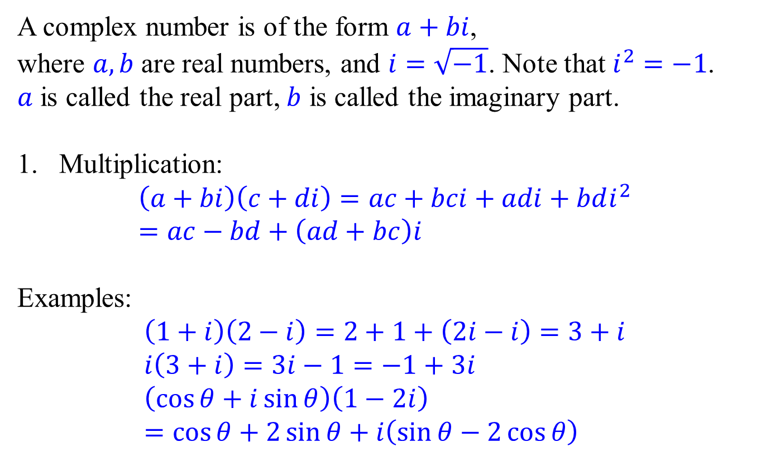
Complex numbers - form and multiplication
A complex number is of the form $a+bi$,
where $a,b$ are real numbers, and $i=\sqrt{−1}$. Note that $i^{2}=−1$.
$a$ is called the real part, $b$ is called the imaginary part.
Multiplication:
$$\left(a+bi\right)\left(c+di\right)=ac+bci+adi+bdi^{2} \\ =ac−bd+\left(ad+bc\right)i$$
Examples:
$$\left(1+i\right)\left(2−i\right)=2+1+\left(2i−i\right)=3+i \\ i\left(3+i\right)=3i−1=−1+3i \\ \left(\cos{θ}+i\sin{θ}\right)\left(1−2i\right) \\ =\cos{θ}+2\sin{θ}+i\left(\sin{θ}−2\cos{θ}\right)$$

Slide 5

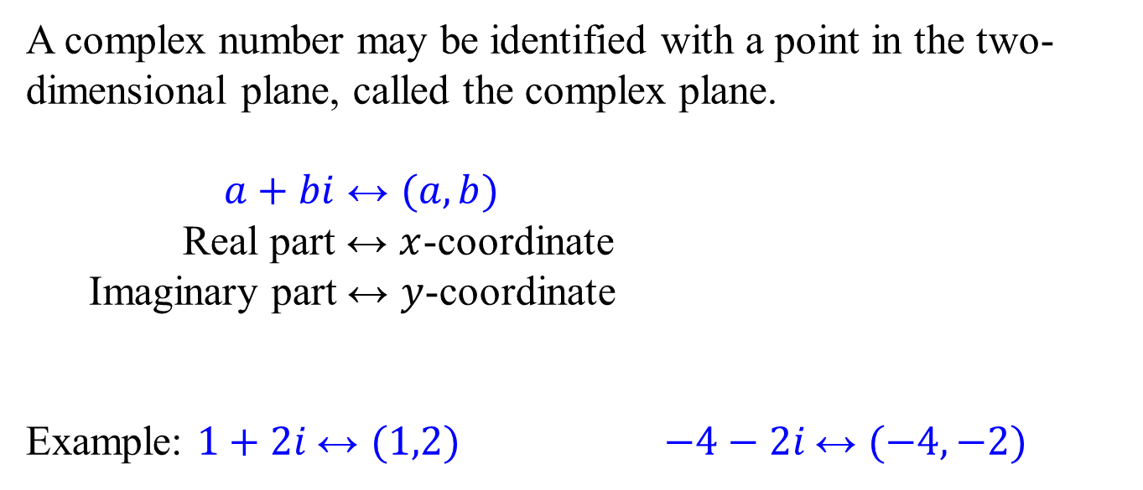








Complex numbers - geometric interpretation
A complex number may be identified with a point in the two-dimensional plane, called the complex plane.
$a+bi↔(a,b)$
Real part $↔x$-coordinate
Imaginary part $↔y$-coordinate
Example: $1+2i$ $↔(1,2)$ $−4−2i$ $↔(−4,−2)$
Imaginary
$$b$$
$$a+bi$$
Real
$$a$$
Imaginary
Imaginary
$$1+2i$$
$$−4$$
$$2$$
Real
Real
$$−2$$
$$−4−2i$$
$$1$$

Slide 6
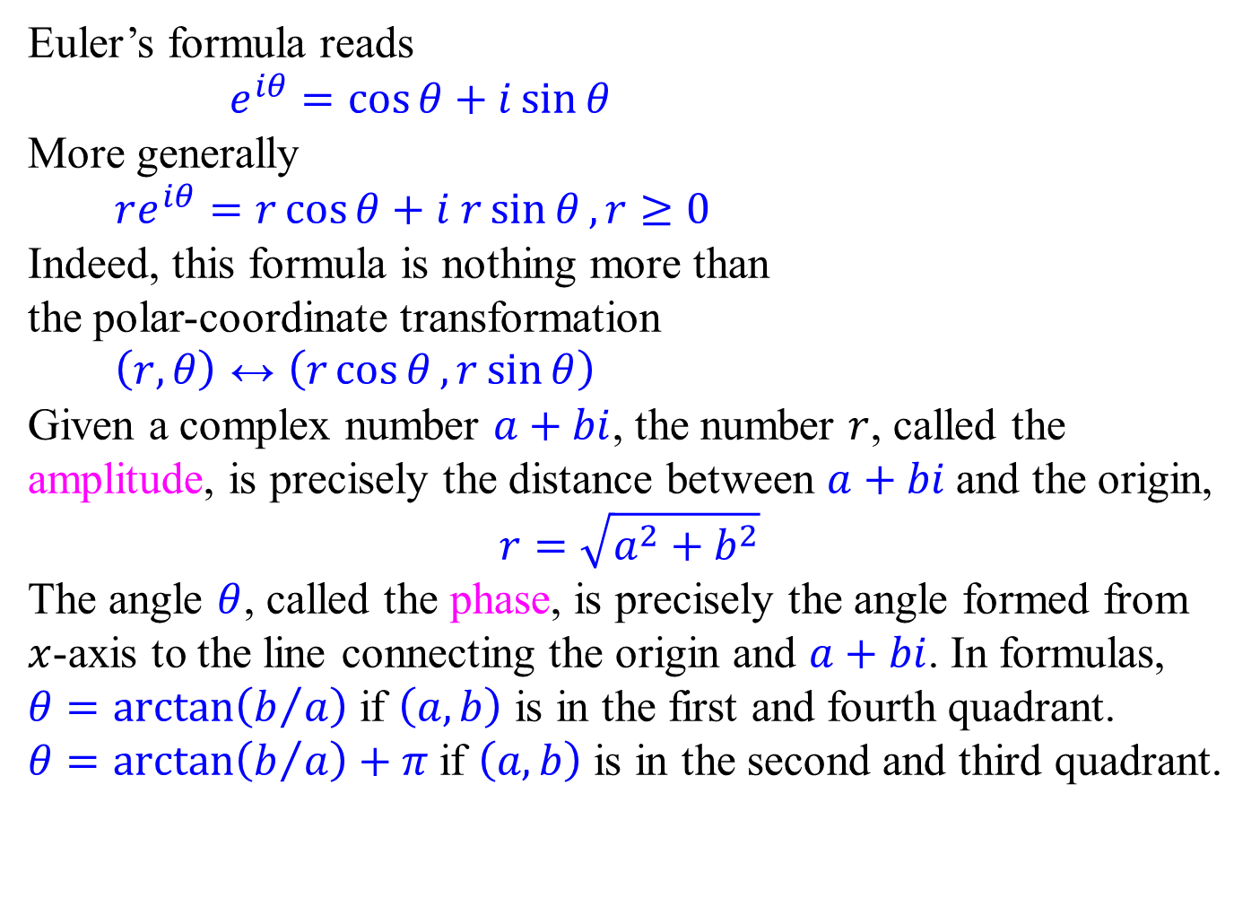




Complex numbers - Euler’s formula
Imaginary
Euler’s formula reads
$e^{iθ}=\cos{θ}+i\sin{θ}$
More generally
$re^{iθ}=r\cos{θ}+i r\sin{θ},r≥0$
Indeed, this formula is nothing more than the polar-coordinate transformation
$\left(r,θ\right)↔\left(r\cos{θ},r\sin{θ}\right)$
Given a complex number $a+bi$, the number $r$, called the amplitude, is precisely the distance between $a+bi$ and the origin,
$$r=\sqrt{a^{2}+b^{2}}$$
The angle $θ$, called the phase, is precisely the angle formed from $x$-axis to the line connecting the origin and $a+bi$. In formulas,
$θ=\arctan\left(b/a\right)$ if $\left(a,b\right)$ is in the first and fourth quadrant.
$θ=\arctan\left(b/a\right)+π$ if $\left(a,b\right)$ is in the second and third quadrant.
$$r sin{θ}$$
$$r$$
$$θ$$
Real
$$r cos{θ}$$

Slide 7

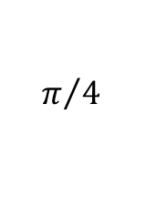


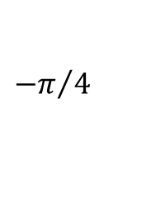


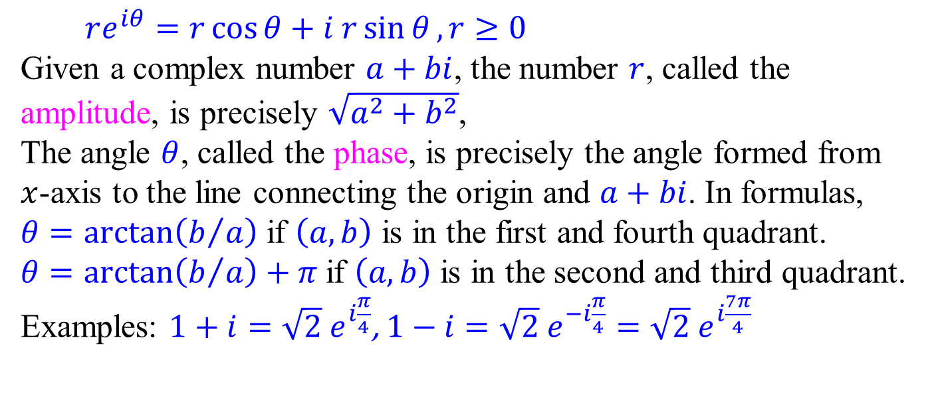

Complex numbers - Euler’s formula
$re^{iθ}=r\cos{θ}+i r\sin{θ},r≥0$
Given a complex number $a+bi$, the number $r$, called the amplitude, is precisely $\sqrt{a^{2}+b^{2}}$,
The angle $θ$, called the phase, is precisely the angle formed from $x$-axis to the line connecting the origin and $a+bi$. In formulas,
$θ=\arctan\left(b/a\right)$ if $\left(a,b\right)$ is in the first and fourth quadrant.
$θ=\arctan\left(b/a\right)+π$ if $\left(a,b\right)$ is in the second and third quadrant.
Examples: $1+i=\sqrt{2} e^{i\frac{π}{4}}$, $1−i=\sqrt{2} e^{−i\frac{π}{4}}=\sqrt{2} e^{i\frac{7π}{4}}$
Imaginary
Imaginary
$$1$$
$$1$$
$$\sqrt{2}$$
$${−π}/4$$
Real
$$\sqrt{2}$$
$$π/4$$
$$−1$$
$$1$$
Real

Slide 8

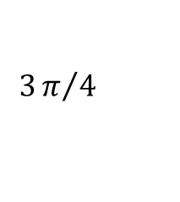


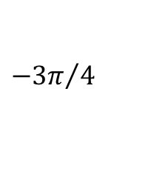


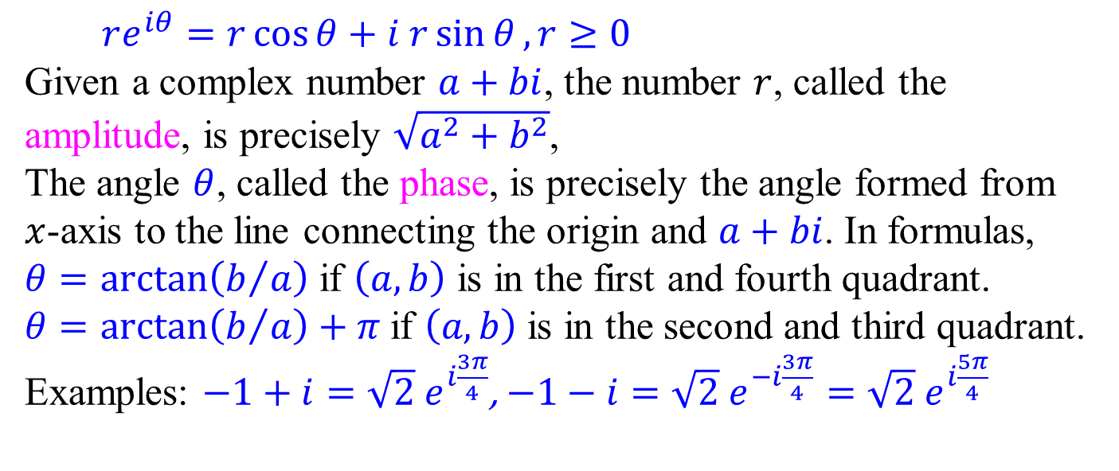

Complex numbers - Euler’s formula
$re^{iθ}=r\cos{θ}+i r\sin{θ},r≥0$
Given a complex number $a+bi$, the number $r$, called the amplitude, is precisely $\sqrt{a^{2}+b^{2}}$,
The angle $θ$, called the phase, is precisely the angle formed from $x$-axis to the line connecting the origin and $a+bi$. In formulas,
$θ=\arctan\left(b/a\right)$ if $\left(a,b\right)$ is in the first and fourth quadrant.
$θ=\arctan\left(b/a\right)+π$ if $\left(a,b\right)$ is in the second and third quadrant.
Examples: $−1+i=\sqrt{2} e^{i\frac{3π}{4}}$, $−1−i=\sqrt{2} e^{−i\frac{3π}{4}}=\sqrt{2} e^{i\frac{5π}{4}}$
Imaginary
Imaginary
$$−1$$
$$1$$
$${−3π}/4$$
Real
$$\sqrt{2}$$
$$3π/4$$
$$\sqrt{2}$$
$$−1$$
$$−1$$
Real

Slide 9
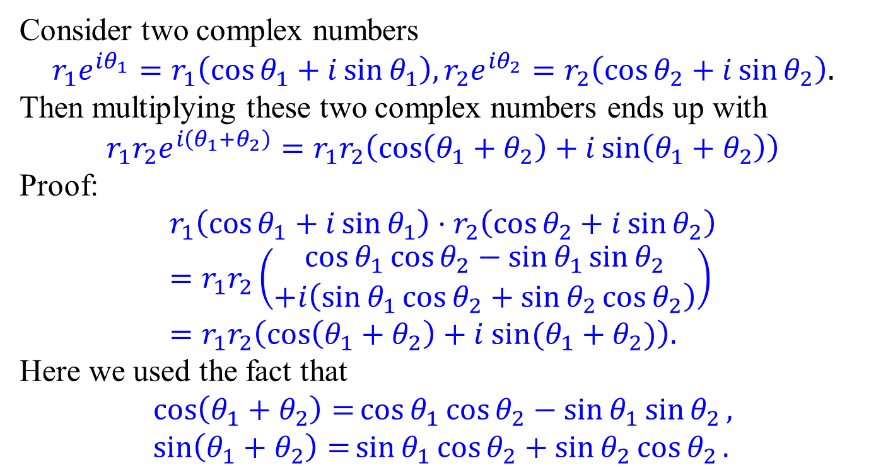
Complex numbers – multiplication revisited
Consider two complex numbers
$$r_{1}e^{iθ_{1}}=r_{1}\left(\cos{θ_{1}}+i\sin{θ_{1}}\right),r_{2}e^{iθ_{2}}=r_{2}\left(\cos{θ_{2}}+i\sin{θ_{2}}\right).$$
Then multiplying these two complex numbers ends up with
$$r_{1}r_{2}e^{i\left(θ_{1}+θ_{2}\right)}=r_{1}r_{2}\left(\cos\left(θ_{1}+θ_{2}\right)+i\sin\left(θ_{1}+θ_{2}\right)\right)$$
Proof:
$$r_{1}\left(\cos{θ_{1}}+i\sin{θ_{1}}\right)⋅r_{2}\left(\cos{θ_{2}}+i\sin{θ_{2}}\right) \\ =r_{1}r_{2}\left(\begin{aligned}\cos{θ_{1}}\cos{θ_{2}}−\sin{θ_{1}}\sin{θ_{2}} \\ +i\left(\sin{θ_{1}}\cos{θ_{2}}+\sin{θ_{2}}\cos{θ_{2}}\right)\end{aligned}\right) \\ =r_{1}r_{2}\left(\cos\left(θ_{1}+θ_{2}\right)+i sin⁡(θ_{1}+θ_{2})\right).$$
Here we used the fact that
$$\cos\left(θ_{1}+θ_{2}\right)=\cos{θ_{1}}\cos{θ_{2}}−\sin{θ_{1}}\sin{θ_{2}}, \\ \sin\left(θ_{1}+θ_{2}\right)=\sin{θ_{1}}\cos{θ_{2}}+\sin{θ_{2}}\cos{θ_{2}}.$$

Slide 10


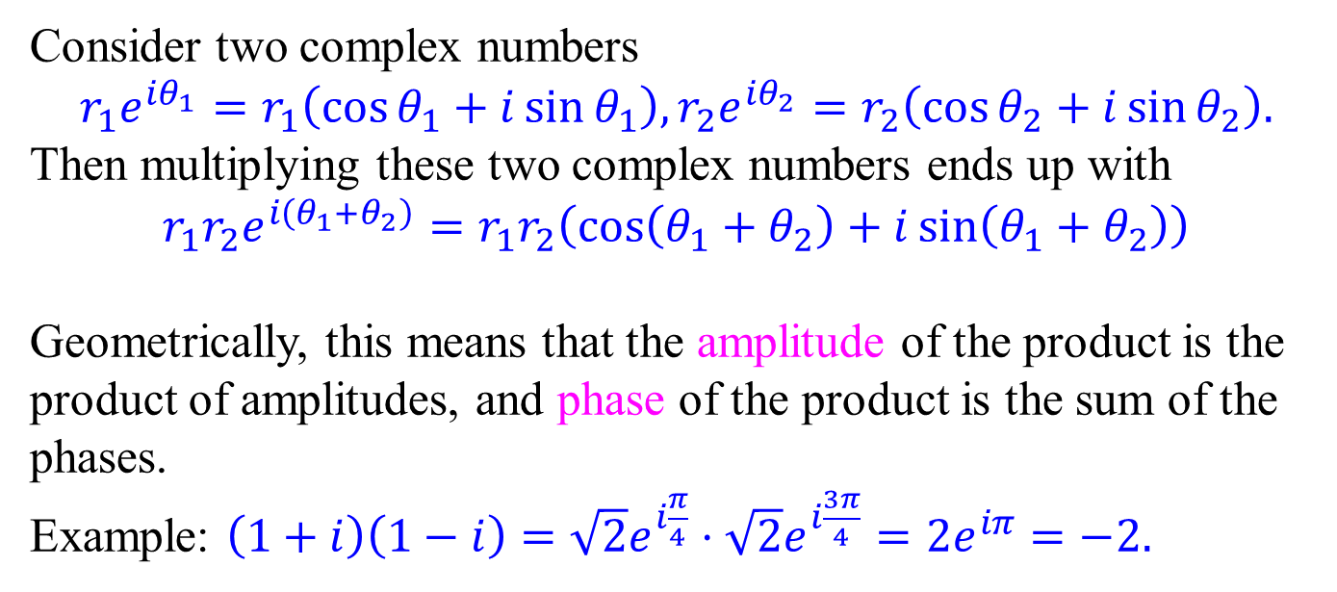


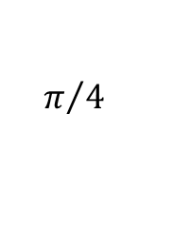


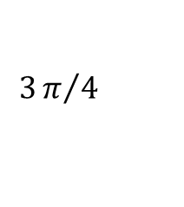



Complex numbers – multiplication revisited
Consider two complex numbers
$$r_{1}e^{iθ_{1}}=r_{1}\left(\cos{θ_{1}}+i\sin{θ_{1}}\right),r_{2}e^{iθ_{2}}=r_{2}\left(\cos{θ_{2}}+i\sin{θ_{2}}\right).$$
Then multiplying these two complex numbers ends up with
$$r_{1}r_{2}e^{i\left(θ_{1}+θ_{2}\right)}=r_{1}r_{2}\left(\cos\left(θ_{1}+θ_{2}\right)+i\sin\left(θ_{1}+θ_{2}\right)\right)$$
Geometrically, this means that the amplitude of the product is the product of amplitudes, and phase of the product is the sum of the phases.
Example: $\left(1+i\right)\left(1−i\right)=\sqrt{2}e^{i\frac{π}{4}}⋅\sqrt{2}e^{i\frac{3π}{4}}=2e^{iπ}=−2.$
Imaginary
Imaginary
Imaginary
$$1$$
$$1$$
$$1$$
$$\sqrt{2}$$
$$\sqrt{2}$$
$$3π/4$$
$$π/4$$
$$π$$
$$−2$$
Real
$$1$$
Real
$$−1$$
Real

Slide 11
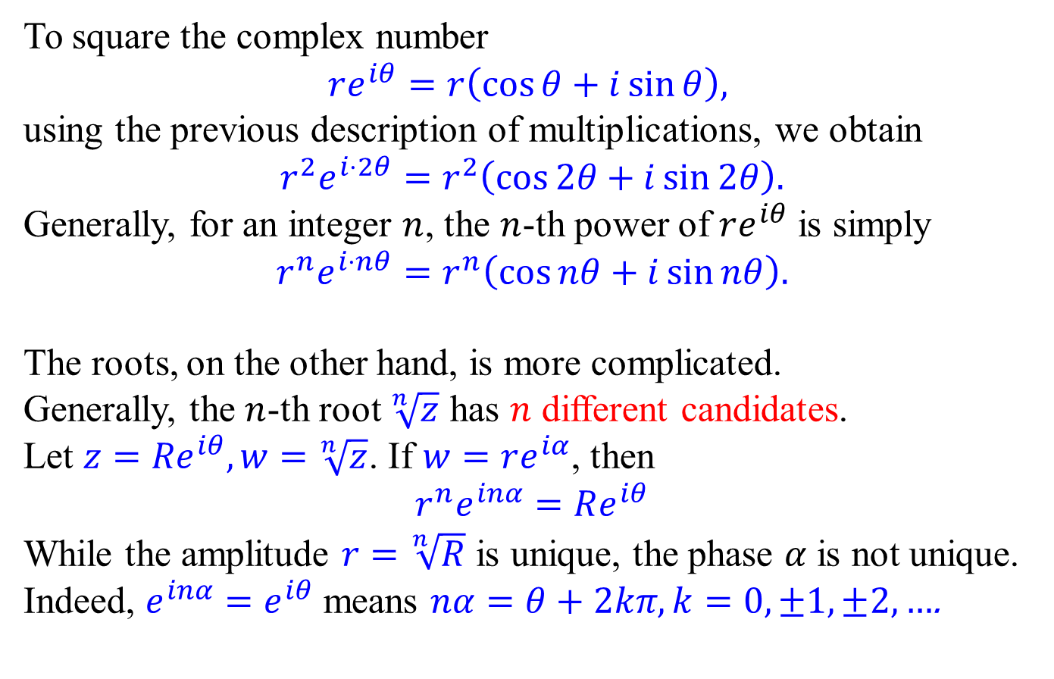
Complex numbers – powers and roots
To square the complex number
$$re^{iθ}=r\left(\cos{θ}+i\sin{θ}\right),$$
using the previous description of multiplications, we obtain
$$r^{2}e^{i⋅2θ}=r^{2}\left(\cos{2θ}+i\sin{2θ}\right).$$
Generally, for an integer $n$, the $n$-th power of $re^{iθ}$ is simply
$$r^{n}e^{i⋅nθ}=r^{n}\left(\cos{nθ}+i\sin{nθ}\right).$$
The roots, on the other hand, is more complicated.
Generally, the $n$-th root $\sqrt[n]{z}$ has $n$ different candidates.
Let $z={Re}^{iθ},w=\sqrt[n]{z}$. If $w=re^{iα}$, then
$$r^{n}e^{inα}=Re^{iθ}$$
While the amplitude $r=\sqrt[n]{R}$ is unique, the phase $α$ is not unique.
Indeed, $e^{inα}=e^{iθ}$ means $nα=θ+2kπ,k=0,±1,±2, …$.

Slide 12
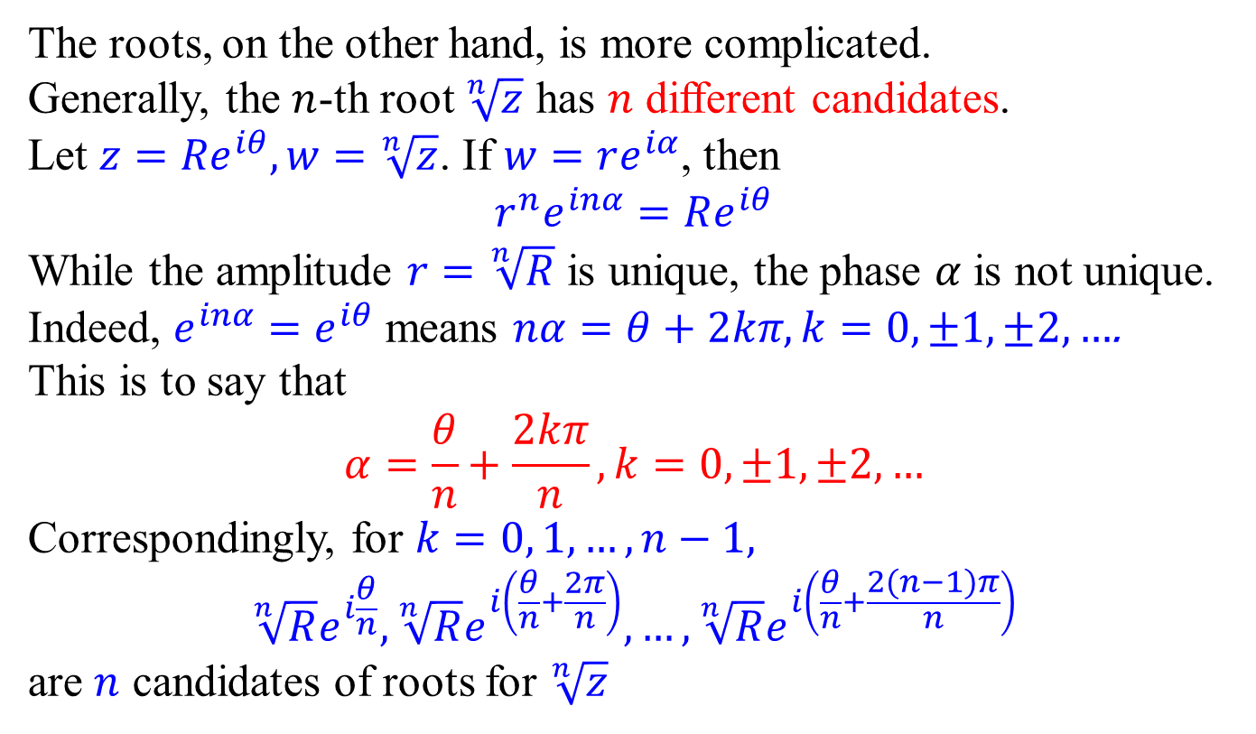
Complex numbers – powers and roots
The roots, on the other hand, is more complicated.
Generally, the $n$-th root $\sqrt[n]{z}$ has $n$ different candidates.
Let $z={Re}^{iθ},w=\sqrt[n]{z}$. If $w=re^{iα}$, then
$$r^{n}e^{inα}=Re^{iθ}$$
While the amplitude $r=\sqrt[n]{R}$ is unique, the phase $α$ is not unique.
Indeed, $e^{inα}=e^{iθ}$ means $nα=θ+2kπ,k=0,±1,±2, …$.
This is to say that
$$α=\frac{θ}{n}+\frac{2kπ}{n},k=0,±1,±2,…$$
Correspondingly, for $k=0, 1, …, n−1,$
$$\sqrt[n]{R}e^{i\frac{θ}{n}},\sqrt[n]{R}e^{i\left(\frac{θ}{n}+\frac{2π}{n}\right)}, …,\sqrt[n]{R}e^{i\left(\frac{θ}{n}+\frac{2(n−1)π}{n}\right)}$$
are $n$ candidates of roots for $\sqrt[n]{z}$

Slide 13
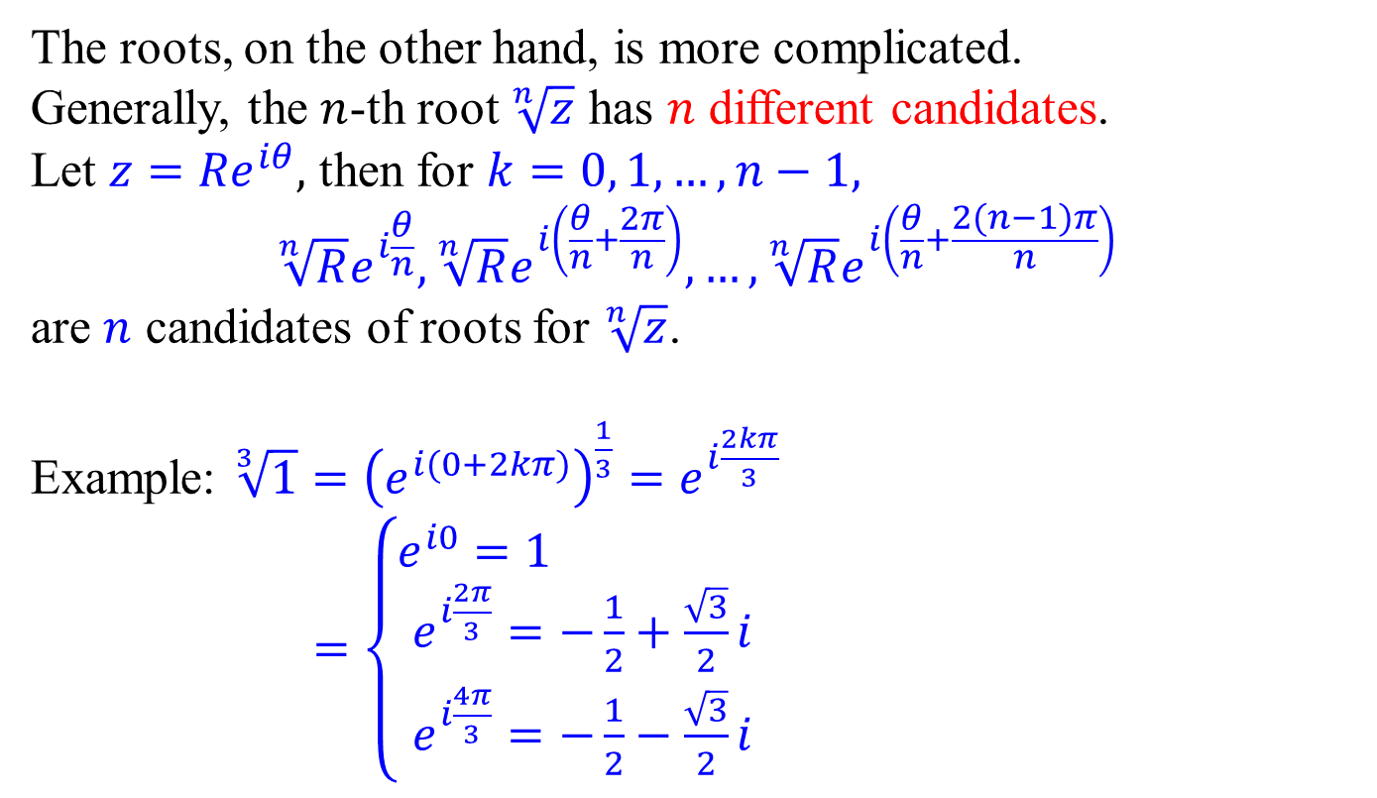
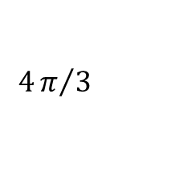
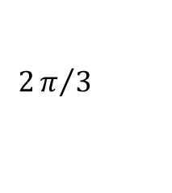


Complex numbers – powers and roots
The roots, on the other hand, is more complicated.
Generally, the $n$-th root $\sqrt[n]{z}$ has $n$ different candidates.
Let $z={Re}^{iθ},$ then for $k=0, 1, …, n−1,$
$$\sqrt[n]{R}e^{i\frac{θ}{n}},\sqrt[n]{R}e^{i\left(\frac{θ}{n}+\frac{2π}{n}\right)}, …,\sqrt[n]{R}e^{i\left(\frac{θ}{n}+\frac{2(n−1)π}{n}\right)}$$
are $n$ candidates of roots for $\sqrt[n]{z}$.
Example: $\sqrt[3]{1}={\left(e^{i(0+2kπ)}\right)}^{\frac{1}{3}}=e^{i\frac{2kπ}{3}}$ $=\left\{\begin{aligned}e^{i0}=1 \\ e^{i\frac{2π}{3}}=−\frac{1}{2}+\frac{\sqrt{3}}{2}i \\ e^{i\frac{4π}{3}}=−\frac{1}{2}−\frac{\sqrt{3}}{2}i\end{aligned}\right.$
Imaginary
$$e^{i\frac{2π}{3}}$$
$$2π/3$$
$$4π/3$$
$$1$$

Slide 14

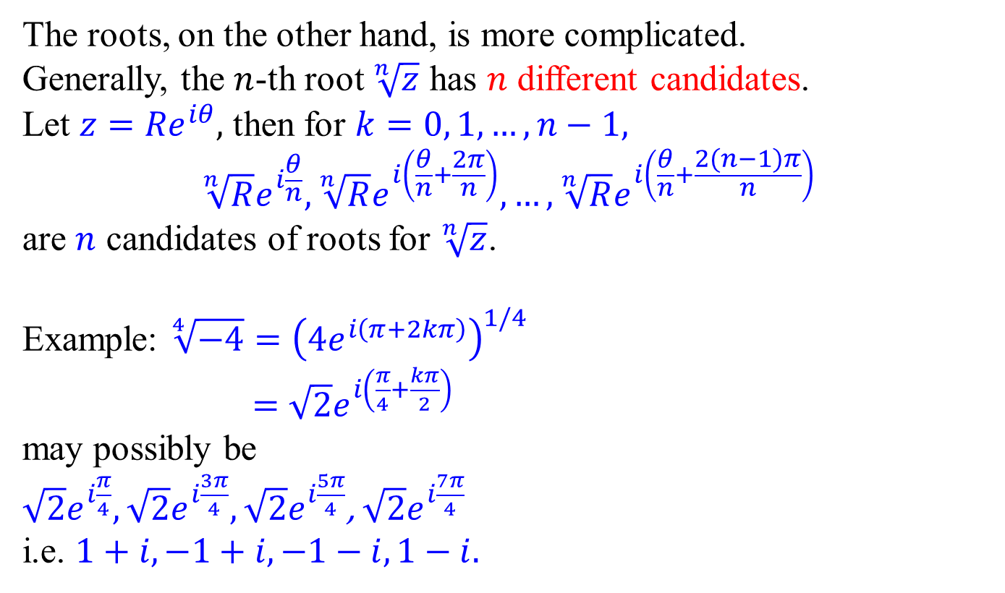




Complex numbers – powers and roots
The roots, on the other hand, is more complicated.
Generally, the $n$-th root $\sqrt[n]{z}$ has $n$ different candidates.
Let $z={Re}^{iθ},$ then for $k=0, 1, …, n−1,$
$$\sqrt[n]{R}e^{i\frac{θ}{n}},\sqrt[n]{R}e^{i\left(\frac{θ}{n}+\frac{2π}{n}\right)}, …,\sqrt[n]{R}e^{i\left(\frac{θ}{n}+\frac{2(n−1)π}{n}\right)}$$
are $n$ candidates of roots for $\sqrt[n]{z}$.
Example: $\sqrt[4]{−4}={\left(4e^{i\left(π+2kπ\right)}\right)}^{1/4}$ $=\sqrt{2}e^{i\left(\frac{π}{4}+\frac{kπ}{2}\right)}$
may possibly be
$\sqrt{2}e^{i\frac{π}{4}},\sqrt{2}e^{i\frac{3π}{4}},\sqrt{2}e^{i\frac{5π}{4}}$, $\sqrt{2}e^{i\frac{7π}{4}}$
i.e. $1+i,−1+i,−1−i,1−i.$
$$e^{i\frac{2π}{3}}$$
Imaginary
$$1$$
$$−1$$
$$1$$
$$−1$$

